Slide 1


ECS 630 - SIMULATIONS AND DATA ANALYTICS – PRESENTATION (revised) SM TRAVEL CALL CENTRE SIMULATION
TEAM MEMBERS: JAYAPRAKASH CHANDRAN (522242685) INDRAJITH THEERTHAGIRI (930968239)

Slide 2
INDEX: (REVISED)
INTRODUCTION
MODELING OBJECTIVES
MODELLING DETAILS & ASSUMPTIONS
INPUT DATA AND DISTRIBUTION
INPUT DISTRIBUTION OF DATA
MODEL EXPLANATION
NOMENCLATURE & FLOW CHART
APPROACH TOWARDS THE MODEL WITH POSSIBLE ANIMATIONS
VERIFICATION
ENTRY MODULE
EXPRESSION LOGIC
PROCESS MODULE AND EXIT SYSTEM
REPLICATION REPORT
VALIDATION AND OUTPUT ANALYSIS
DOE ANALYSIS
EXACT SUMMARY TIPS AND RECOMMENDATIONS

Slide 3
INTRODUCTION:
SM Travel is setting up its offices in two areas, one located overseas and another one in the U.S, which will all serve the purpose of handling all phone requests
The existing system is a call headquarter which is meant to make travel bookings for the callers. Together with the minimization of operational expenses, there is a need for lowering the wait duration for the clients.
To optimize the operating cost of SM Travel's new call center system, a computer simulation can be used. The new system is intended to handle travel reservations from regular and cardholder customers, with the latter receiving preferential treatment.
The system will have limited trunk lines available, and busy signals will be recorded when all lines are in use.
The proposed method for reducing busy signals for cardholders is to reserve a specific number of lines for them when the system is congested.
By building an Arena model, there is a possibility of recommending an affordable system setting which will aim at achieving the required customer performance level.
This simulation-based approach allows for thorough analysis and fine-tuning of the system, resulting in an optimal and cost-effective solution. The ultimate goal is to provide exceptional customer service while managing operational costs efficiently.

Slide 4
MODELLING OBJECTIVES:
Calculate the projected waiting time.
Identify the nature of the incoming calls and the available pool of operators.
Performing based on the Membership ID, So the Cardholder customer gets the high priority.
Determine the number of operators required for each shift and call type.
Establish an acceptable level of waiting time.
Determine the hourly cost.
To provide a recommendation for estimating the expected wait times by customer type
The operators' shifts can be aligned with the customer arrival rates, with more operators available during peak hours.
The simulation can also estimate the number of trunk lines needed to handle the expected volume of calls.

Slide 5
MODELLING DETAILS & ASSUMPTIONS:
Reservation of Trunk Lines: Instead of assuming that the last 25% of the trunk lines will automatically be reserved for cardholder customers when 75% of the lines are engaged, you could consider implementing a more dynamic system that adjusts based on real-time call traffic. For example, It could use an algorithm that analyzes the incoming call volume and assigns trunk lines, accordingly, giving priority to cardholders when necessary.
Operator Shift Patterns: It's important to take into account the fact that operators work in shifts, which can impact call availability and response rates. The company could develop a system that takes operator shift patterns into account and adjusts call routing and trunk line allocation accordingly.
Membership Numbers: Mentioning the membership numbers are assumed to have numeric values only. However, in reality, membership numbers may contain letters, symbols, or a combination of both. It's important to consider different types of membership numbers and develop a system that can handle them appropriately.
Customer Segmentation: In addition to separating cardholders from regular customers, it could consider further segmenting customers based on factors such as call volume, call duration, and customer loyalty. This could help to provide even better service to your most valuable customers.
Peek hours: This approach recognizes the criticality of allocating resources based on demand patterns and emphasizes the need to prioritize operator availability during peak hours. By doing so, we anticipate a significant reduction in customer waiting times, resulting in improved customer satisfaction and retention.

Slide 6
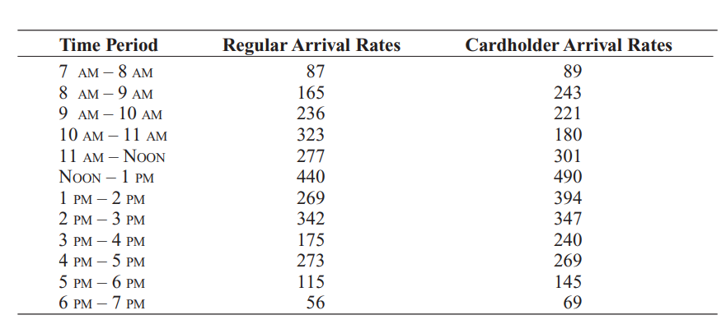
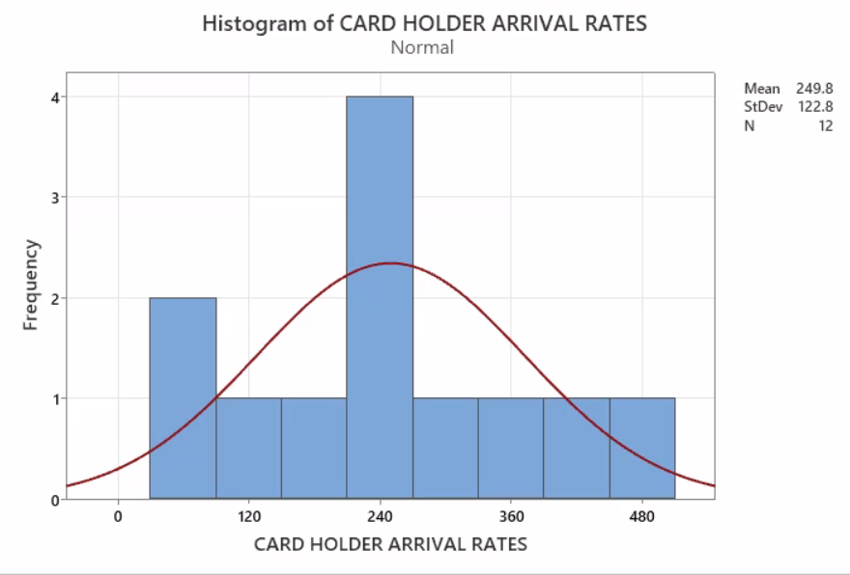
INPUT DATA AND DISTRIBUTION:
We have analysed the data in the Minitab and came across the mean 249.8 and standard deviation of CARD HOLDER ARRIVAL RATES.

Slide 7
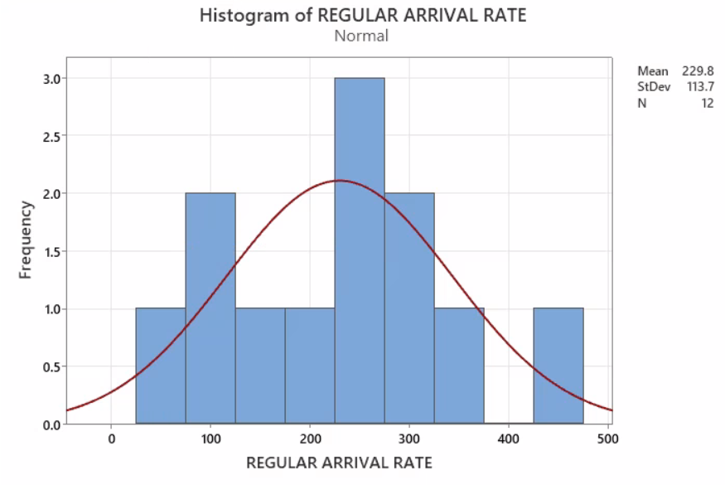
INPUT DATA AND DISTRIBUTION:
We have analysed the data in the Minitab and came across the mean 229.8 and standard deviation of the Regular arrival rate.

Slide 8
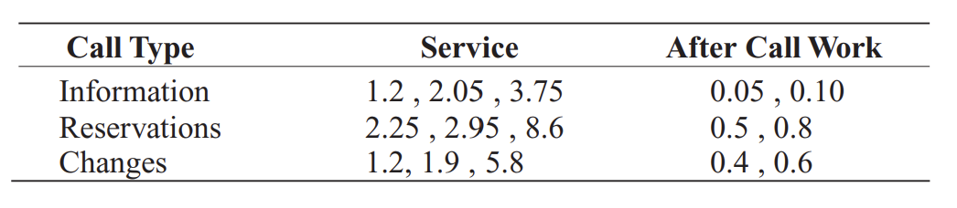
INPUT DISTRIBUTION OF DATA:
For each incoming call type, the service provision time for the desired process and the time for post-call work is given as per the below table
Operating cost for each operator and trunk line is

Slide 9
MODEL EXPLANATION:
The entry section of the system distinguishes between incoming calls and cardholder arrivals.
Card holder represents GOLD & SILVER, whereas Regular Card Holder represents NORMAL customer.
Through a combination of efficient scheduling, process improvements, and effective utilization of available resources, we strive to achieve the desired customer service levels while keeping operating costs at a minimum.
These calls then pass through a decision module that uses the record module to determine whether they are regular or congested calls.
After this, the calls are routed through the trunk line process, during which the system calculates the estimated wait time for customers and allocates priority based on their membership ID.
The system will have limited trunk lines available, and busy signals will be recorded when all lines are in use.
The simulation needs the number of trunk lines needed to handle the expected volume of calls.
Throughout this process, the system prioritizes the needs of the customer and ensures that they receive the best possible service.
Finally, the calls are processed through the disposal module, and the customer's needs are met.

Slide 10
NOMENCLATURE:
Day = D; Time = T​
US Location = USL; Overseas Location = OSL​
Call arrival Time = CAT; Current Time = CT​
Regular customer = RC; Cardholder customer = CHC​
Incoming call = IC​
Busy signal = BS; Record busy signal = RBS​
Trunk line = TL; Trunk line available = TLA​
Wait for time tolerance for regular customers = WTRC​
Wait time tolerance for cardholder customers = WTCHC​
Attended call = AC​
Attended call = AC​
Member number = MN​
Call purpose = CP​
Information request = IR​
Making reservation for trip = MR​
Changing reservation = CR​
Process request = PR​
Post call work = PW​
Customer exit = CE​

Slide 11
Start
Flowchart
WTCHC=RBC
RBC=CT-(IT+CAT)<17
AC
TLA=TLA+1
AC=OA-1
D=T=IT=CT=CAT=IC=0; TL=50
Customer exit due to long waiting time
No
Determine CP
Customer In
IT=CAT
CAT=IT+CAT
IC<720
Yes
CP=IR
CE
TLA=TLA+1
PCW Process
Yes
PR
No
OSL
No
CP=MRT
CE
TLA=TLA+1
Yes
Yes
PR
PCW Process
USL
End
RBC
RBC=CT-(IT+CAT)
RBC>17
No
IF IC=DN,DC=CHC=SCHC=GCHC
CP=CR
Yes
CE
TLA=TLA+1
PCW Process
No
No
Yes
PR
RBC
RBC=CT-(IT+CAT)
RBC>30
No
Yes
Yes
TLA=?,
TLA=TL=TL-1;TLA<4
TLA
TLA=TLA-1
No
RBC
RBC=CT-(IT+CAT)
RBC>30
Update MN
MN>0
Yes
No
Yes
TLA=0RC=BS
Yes
Yes
No
No

Slide 12
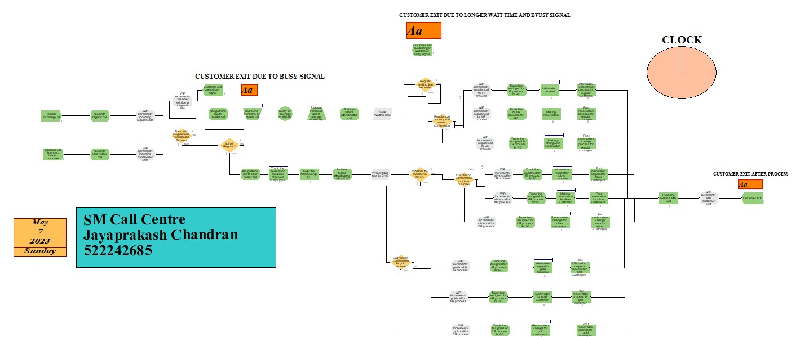
APPROACH TOWARDS THE MODEL WITH POSSIBLE ANIMATIONS:

Slide 13
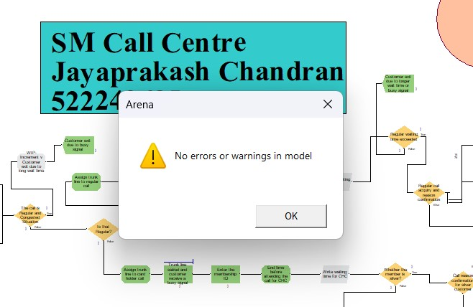
VERIFICATION:
Our modeling approach correctly depicts the system defined in the problem statement.
We have used Expressions and Record to record the modules of each arrival and exit rate.
Moreover, the Membership ID verification is correctly used to identify what caller arrives at customer care.
It was found to be no error in the model, which shows our verification is successful.

Slide 14
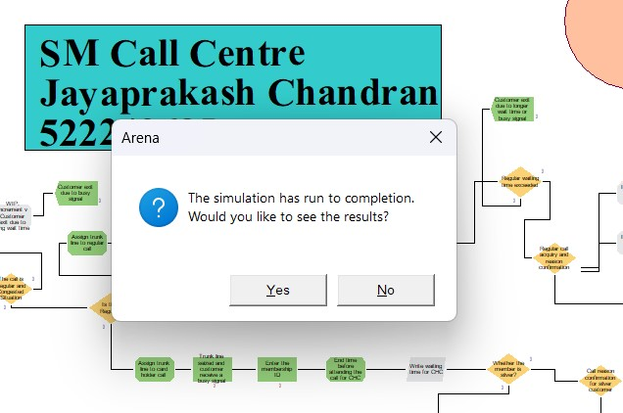
VERIFICATION CONT:
According to the customer’s needs like making and changing the reservation, and requesting the information has been assigned correctly.
The number of customers exit due to busy signal, exit after post process has been assigned correctly.
Priority to the Gold customer when they tend to make changes in reservation, booking or getting information on desired sources is done successfully.

Slide 15
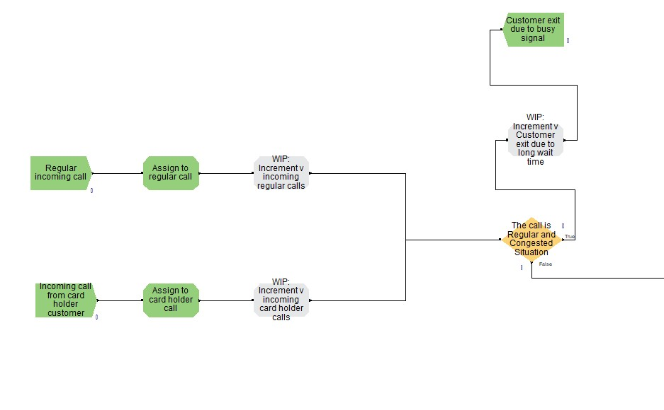
ENTRY MODULE:
The entry module of our system has been divided into two distinct parts to handle regular incoming calls and cardholder customers separately.
This allows the system to efficiently manage and prioritize different types of calls based on their nature and importance.
The regular incoming call module is designed to handle calls from non-members and new customers, while the cardholder customer module is designed to handle calls from existing customers who have a membership ID.
This approach helps to ensure that each type of call is routed to the appropriate operator and given the appropriate level of priority based on the customer's needs.

Slide 16
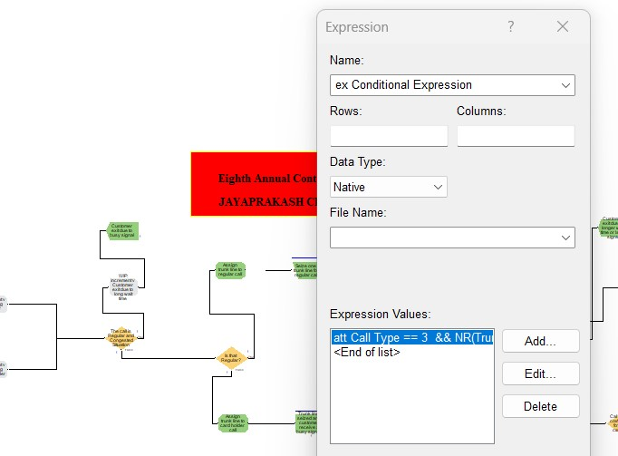
EXPRESSION LOGIC:
Expression logic here we used in the decision module is att Call Type == 3 && NR(Trunk line)/MR(Trunk line) > 0.75
And we have used this formula wherever the decision is made based on the selection. Why do we use this formula? If the trunk line is filled with 75% of Card Holder customers, then it automatically diverts the call to regular ones.

Slide 17
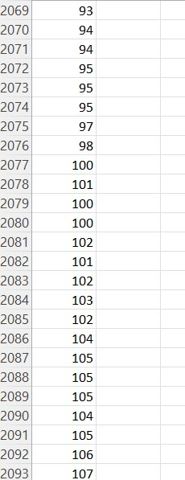
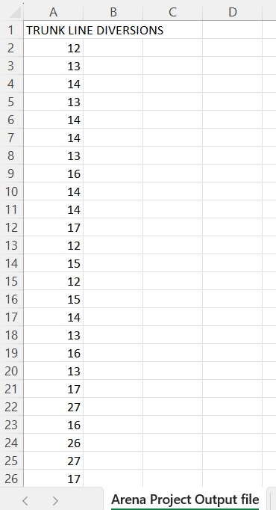
EXPRESSION LOGIC CONT:
The expression modules are implemented to redirect trunk lines of card-holding customers, but only if their volume exceeds 75% of the total.
These modules are configured in an Excel file saved in CSV format. The file contains a total of 2093 entries, generated from 20 REPLICATIONS, Each replication spans 10 days, with a 12-hour timeframe.
These entries reflect the diversion of trunk lines based on the specified criteria, ensuring efficient handling of customer calls and optimizing the overall system performance.

Slide 18
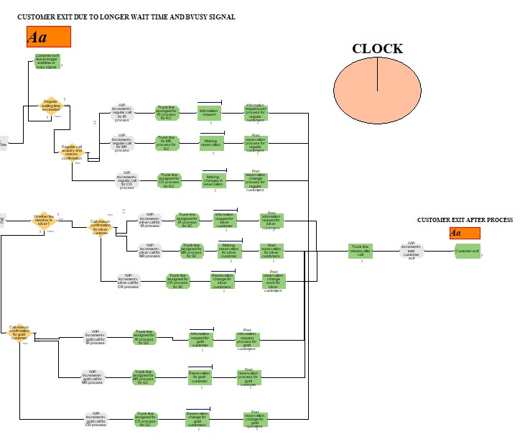
PROCESS MODULE AND EXIT SYSTEM
Our system includes process modules that are responsible for meeting the needs of customers and ensuring their satisfaction. These modules work in conjunction with other modules in the system to provide a seamless and efficient customer service experience.
Once a customer's needs have been identified and addressed, the system decides whether or not the customer's needs have been fully satisfied. If the customer is satisfied, the system will exit the call and complete the service request.
If the customer's needs have not been fully satisfied, the call will be redirected to the appropriate module or operator to ensure that the customer's needs are fully met.
By utilizing these process modules, we are able to ensure that our customers receive the highest quality service and support and that their needs are fully met.

Slide 19
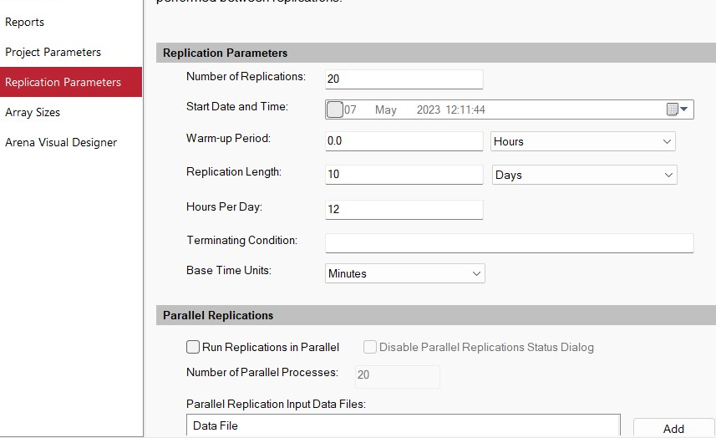
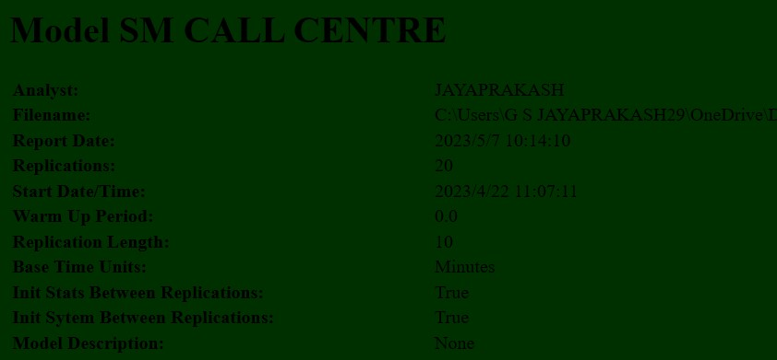
REPLICATION REPORT:
In our simulation, we performed 20 replications. And it can be performed even more if it’s required. Multiple replications are often performed to account for variability and randomness within the system. By running the simulation model multiple times, researchers can gather statistical data and analyze the system's performance across different scenarios or input conditions.

Slide 20
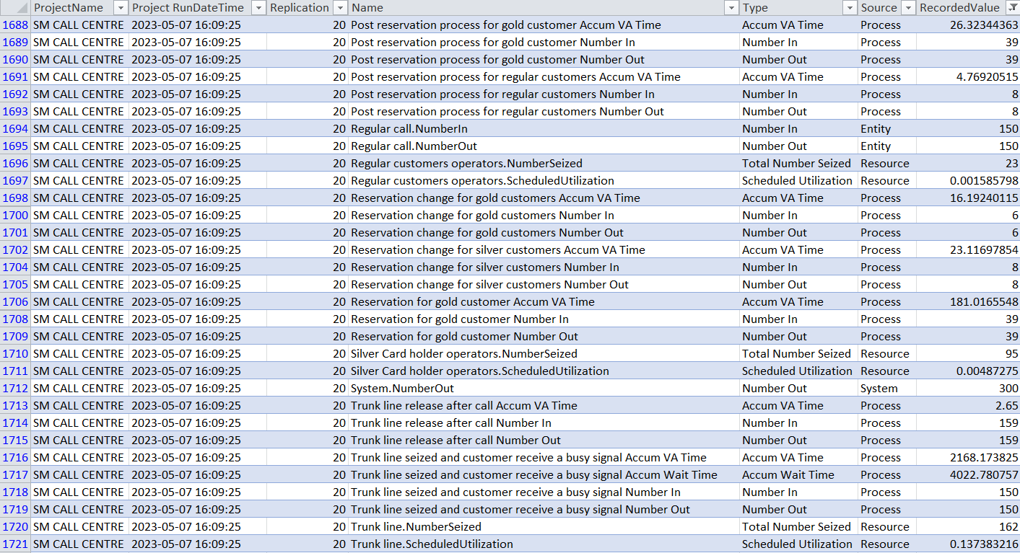
VALIDATION AND OUTPUT ANALYSIS:
After running the model for the desired timeline, which includes 20 replications with a length of 10 days and 12 hours per day, the recorded value shows apex 4022 customers are handled with 50 Trunk lines.
This data reflects the cumulative number of customers who have completed their interactions and left the system according to the given data.
By analyzing this output data, we can gain insights into the efficiency and effectiveness of the system in handling customer requests.
The average number of customers exiting the process serves as a performance indicator, highlighting the rate at which customers are successfully served and concluding their interactions.
This information is valuable in assessing the system's ability to manage customer flow and minimize waiting times, ultimately contributing to an improved customer experience and potentially higher customer retention rates.

Slide 21
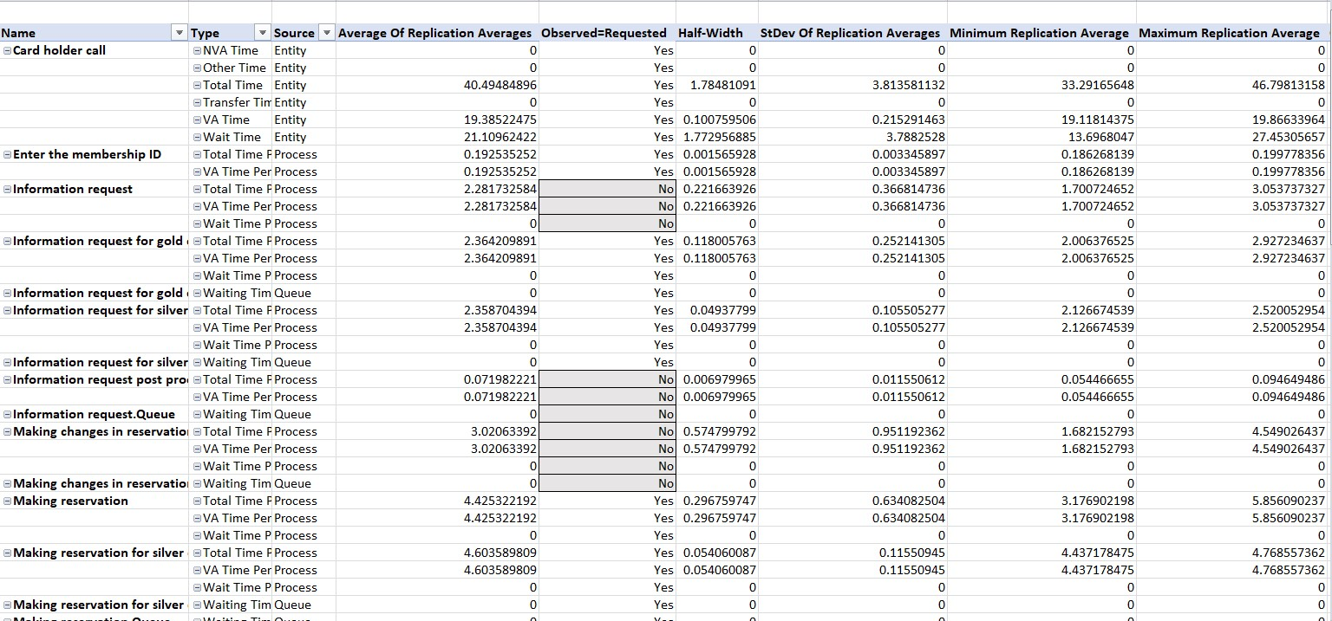
VALIDATION AND OUTPUT ANALYSIS:
Our simulation model takes into account customer preferences, particularly for cardholders who enter their IDs for verification. If the ID says “NO”, which means it’s a regular customer. As we get to know that “information request in Gold/ silver” is meant to be “YES”. This prioritization ensures that cardholders receive preferential treatment within the system. Where our Observation = Requested performed correctly.
By increasing the number of operators, we anticipate a reduction in customer wait times and improved overall customer satisfaction. This adjustment aims to address the identified issue and enhance the efficiency of the system.

Slide 22
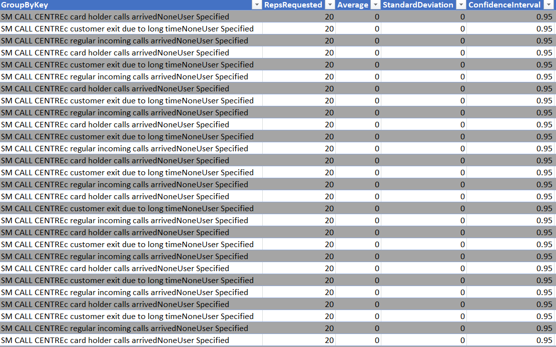
VALIDATION AND OUTPUT ANALYSIS:
After running the simulation in Arena for 20 replications, we obtain a 95% confidence interval. This indicates that we are 95% confident that the true average waiting time for 50 trunk lines and 15 staff members, where customers are prioritized based on Gold, Silver, and regular categories, falls within the range provided by the simulation results.
It proves that Validation is good enough for the representation of the actual model.

Slide 23
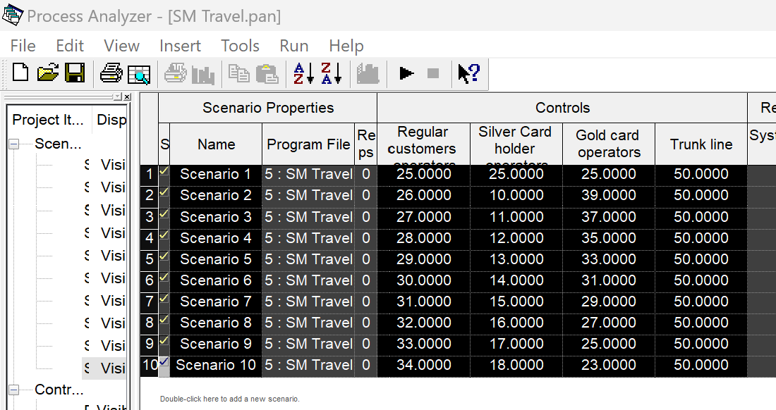
DOE ANALYSIS:
What is DOE, and why do we use it? Design of Experiments (DOE) is a powerful technique used to optimize processes and systems by systematically varying input factors and analyzing their impact on the output. In the context of Arena simulation software, DOE can be applied to analyze and improve the performance of simulation models. Here's how you can implement DOE in Arena.
We performed the DOE analysis using PAN by considering 2 crucial factors i.e. number of operators for regular, silver, and gold customers and available trunk lines. This was conducted to check their significance to our model.

Slide 24
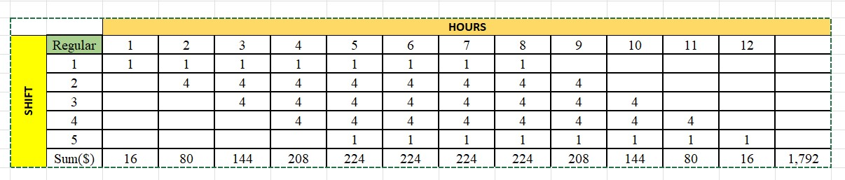
DOE ANALYSIS CONT (COST RECOMMENDATION):
Here, the main aim is to limit the number of operators through type and shift patterns along with the trunk lines.
Number of regular operators x2,…, x5
Number of Silver operators x6, x7,…,x10
Number of gold operators x11, x12,..,x15
After conducting our analysis, we have formulated schedules for operators that aim to minimize costs and effectively cater to customer demands based on shifts and hours.
Considering the customer activity distribution observed in Minitab, where a significant number of customers are present between 11 AM and 2 PM, we have devised tailored schedules for regular, gold, and silver customers.
NO. OF OPERATORS

Slide 25
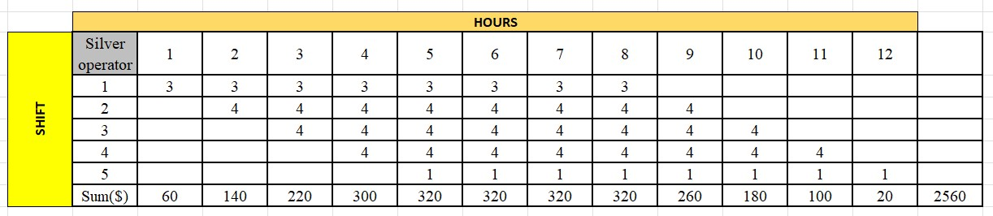
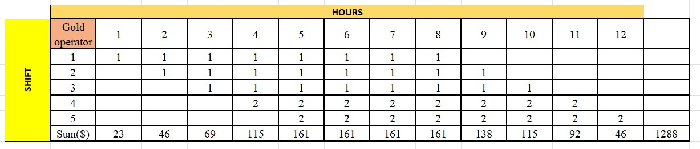
DOE ANALYSIS CONT (COST RECOMMENDATION):
By considering various scenarios and running multiple replications, we have been able to assess the impact of different cost factors and identify the most efficient configuration. This approach ensures that the cost system is robust and capable of delivering optimal results consistently.
The utilization of multiple replications has allowed us to capture the inherent variability and randomness in the system, providing a comprehensive understanding of its behavior and performance.
This analysis has enabled us to make informed decisions and implement a cost system that maximizes efficiency and minimizes expenses.

Slide 26
EXACT SUMMARY TIPS AND RECOMMENDATIONS :
Number of Trunk Lines: Considering an average daily call volume of approximately 4000 calls, our current configuration of 50 trunk lines is insufficient to effectively handle customer demands based on their schedules. Consequently, a substantial number of customers are experiencing lengthy wait times in the queue.
Customer Priority: Gold and silver customers are given priority over regular customers, resulting in longer wait times for regular customers. Consider discussing the impact of this on overall customer satisfaction and the potential benefits of providing some level of priority to new/regular customers as well.
Operator Pool Rate: Increasing the operator pool rate for different types of customers could improve call attending rate efficiency. Consider providing more detail about how this rate is currently determined and how it could be increased. You could also discuss potential trade-offs between increasing the operator pool rate and other factors, such as cost or operator availability.
Consider other factors: In addition to trunk lines, customer priority, and operator pool rate, there may be other factors that could impact call congestion and customer wait times. For example, consider the use of automated call routing or self-service options to reduce call volume and improve efficiency.
Data analytics: Consider the use of data analytics to identify patterns in call traffic and optimize call routing and operator allocation.
6. Wait time Queue: To enhance customer satisfaction, it is crucial to minimize the wait time in the queue. Extended wait times can lead to customer frustration and potentially result in customer abandonment, leading to potential revenue loss for the company. Therefore, reducing the wait time is essential to ensure a positive customer experience and maintain customer loyalty.

Slide 27
THANK YOU!

